Slide 1


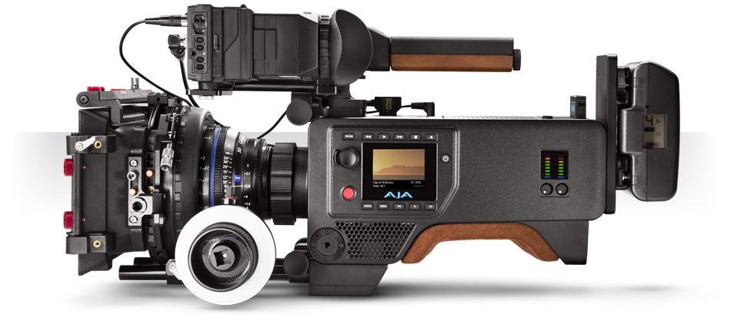

Slide 2
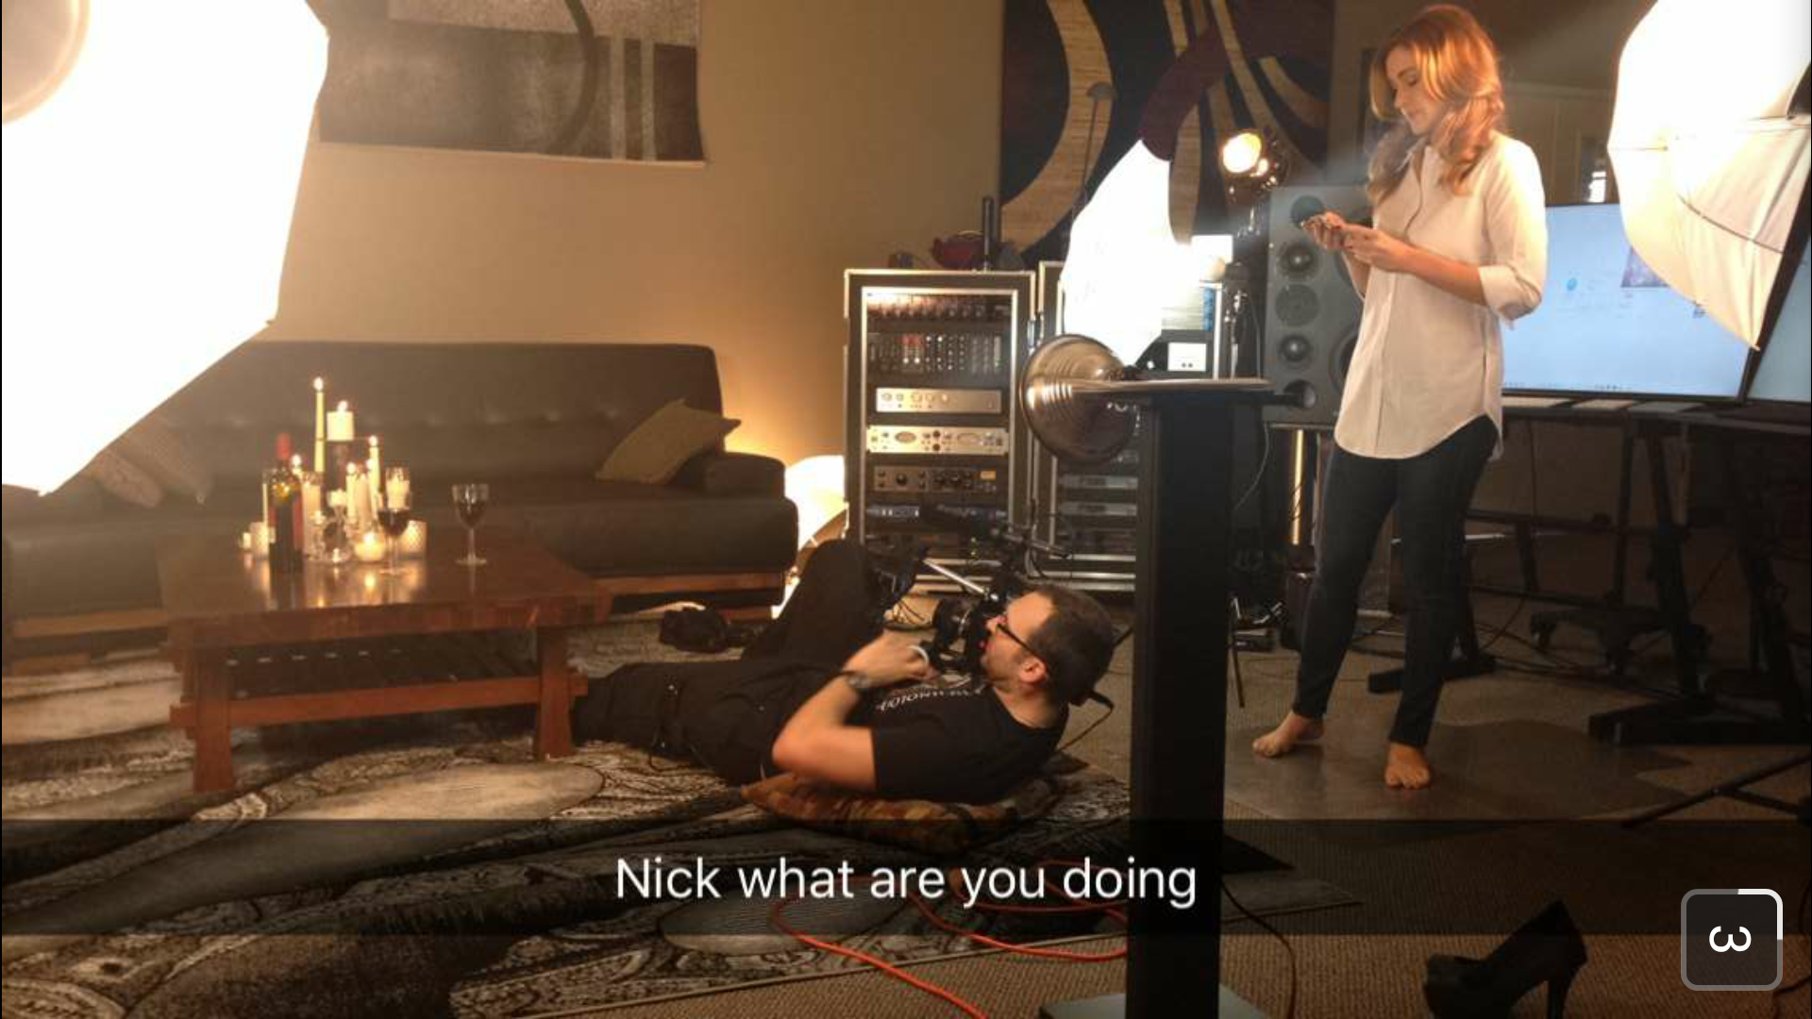
Why Should you Listen to Me?
Short Answer: Because Not-So-Glorious Filmmaking is what I’m Good At

Slide 3
The Process of (almost) Every Project
Idea & Outline
Script (and storyboard?)
Equipment and Location
Planning and Scheduling
Execution
Post Production (Editing, VO, ADR, Etc.)
Production & Distribution

Slide 4
The Process of (almost) Every Project
Idea & Outline
Script (and storyboard?)
Equipment and Location
Planning and Scheduling
Execution
Post Production (Editing, VO, ADR, Etc.)
Production & Distribution

Slide 5
Idea & Outline
Start with the Most Basic Idea
Make an Outline or Timeline
of the parts to include
Reorder them until it makes
sense

Slide 6
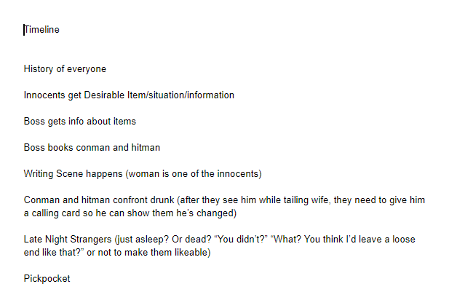
Idea & Outline
Start with the Most Basic Idea
Make an Outline or Timeline
of the parts to include
Reorder them until it makes
sense

Slide 7
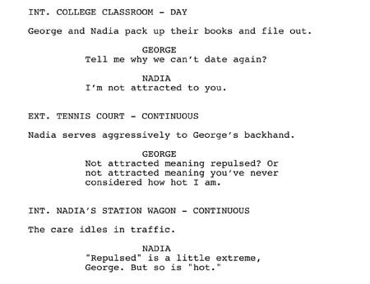
Script
Official Script

Slide 8
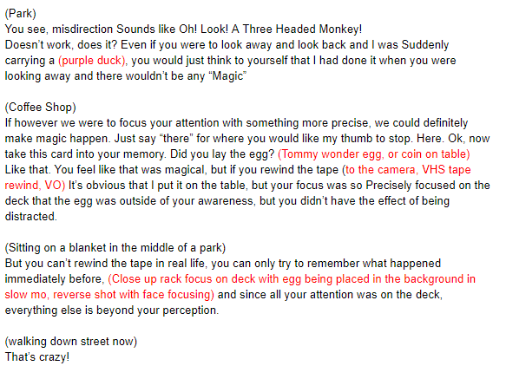
Script
Official Script
My Script

Slide 9
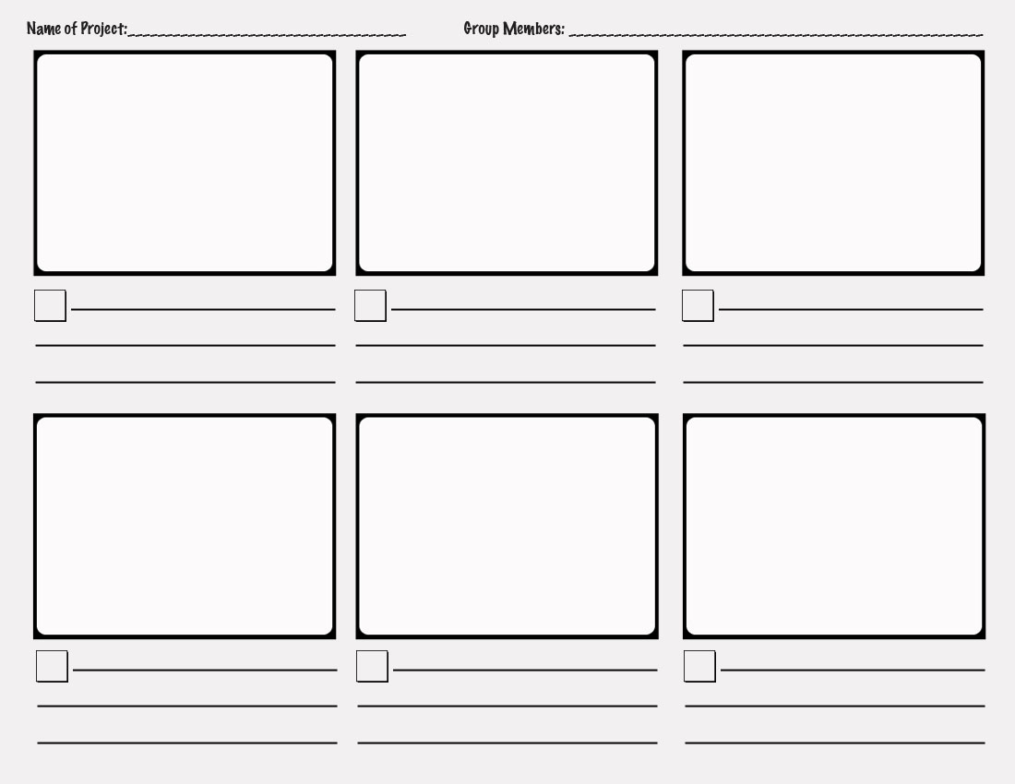
Storyboard

Slide 10
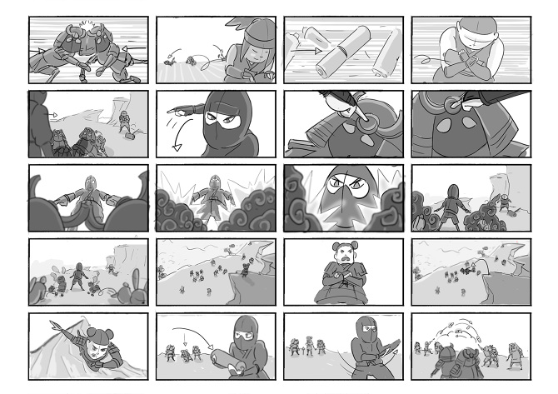
Storyboard

Slide 11
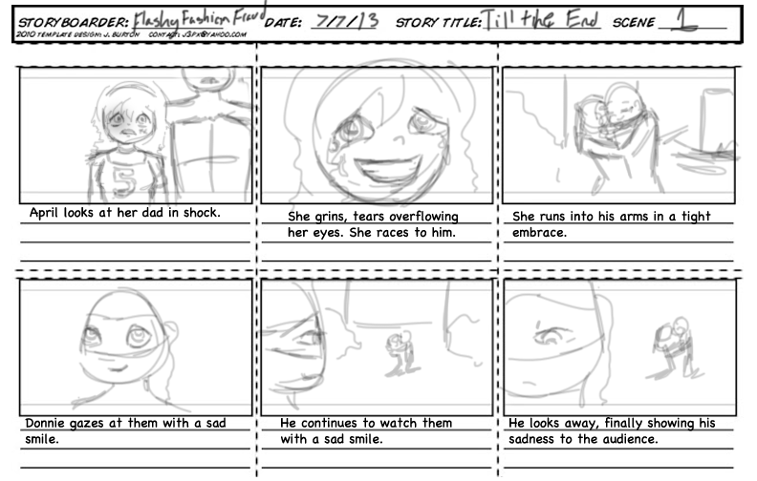
Storyboard

Slide 12
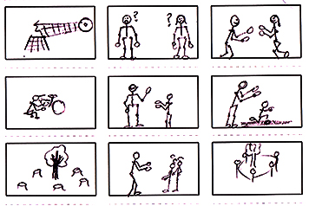
Storyboard

Slide 13
Equipment & Location

Slide 14
Equipment
Camera
Sound
Lighting
Set

Slide 15
Equipment
Above Minimal Camera Requirements:
1080p+
Sound Input (optional, but makes things easy)
Manual Mode
Optical Zoom or Switchable lenses
(no, this doesn’t rule out phones)

Slide 16
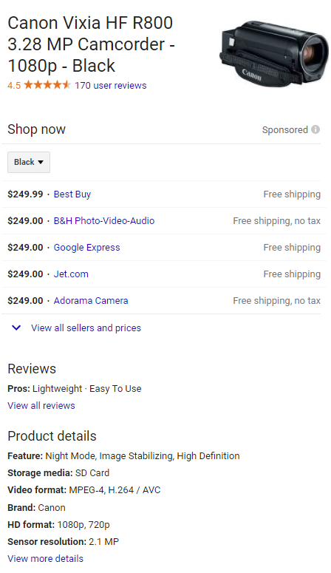
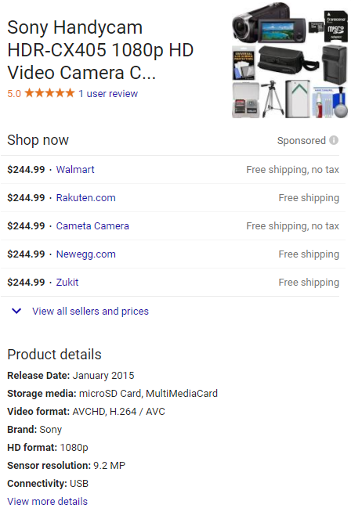

Slide 17
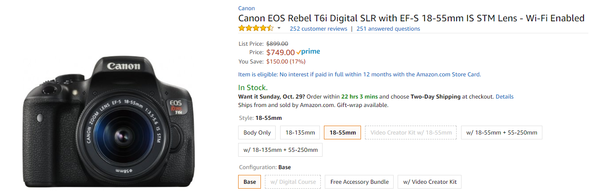

Slide 18
Equipment
Minimal Camera Requirements:
Anything Digital
that works.

Slide 19
Equipment
Above Minimal Sound Requirements:
A Mic that fits your situation
A Thing to capture sound

Slide 20
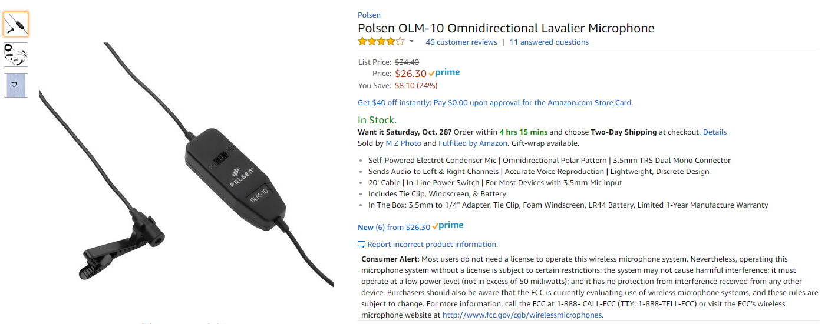
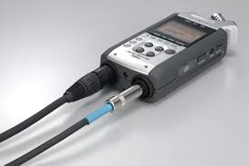
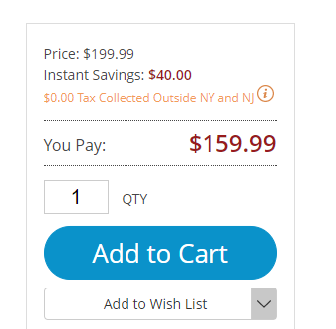

Slide 21
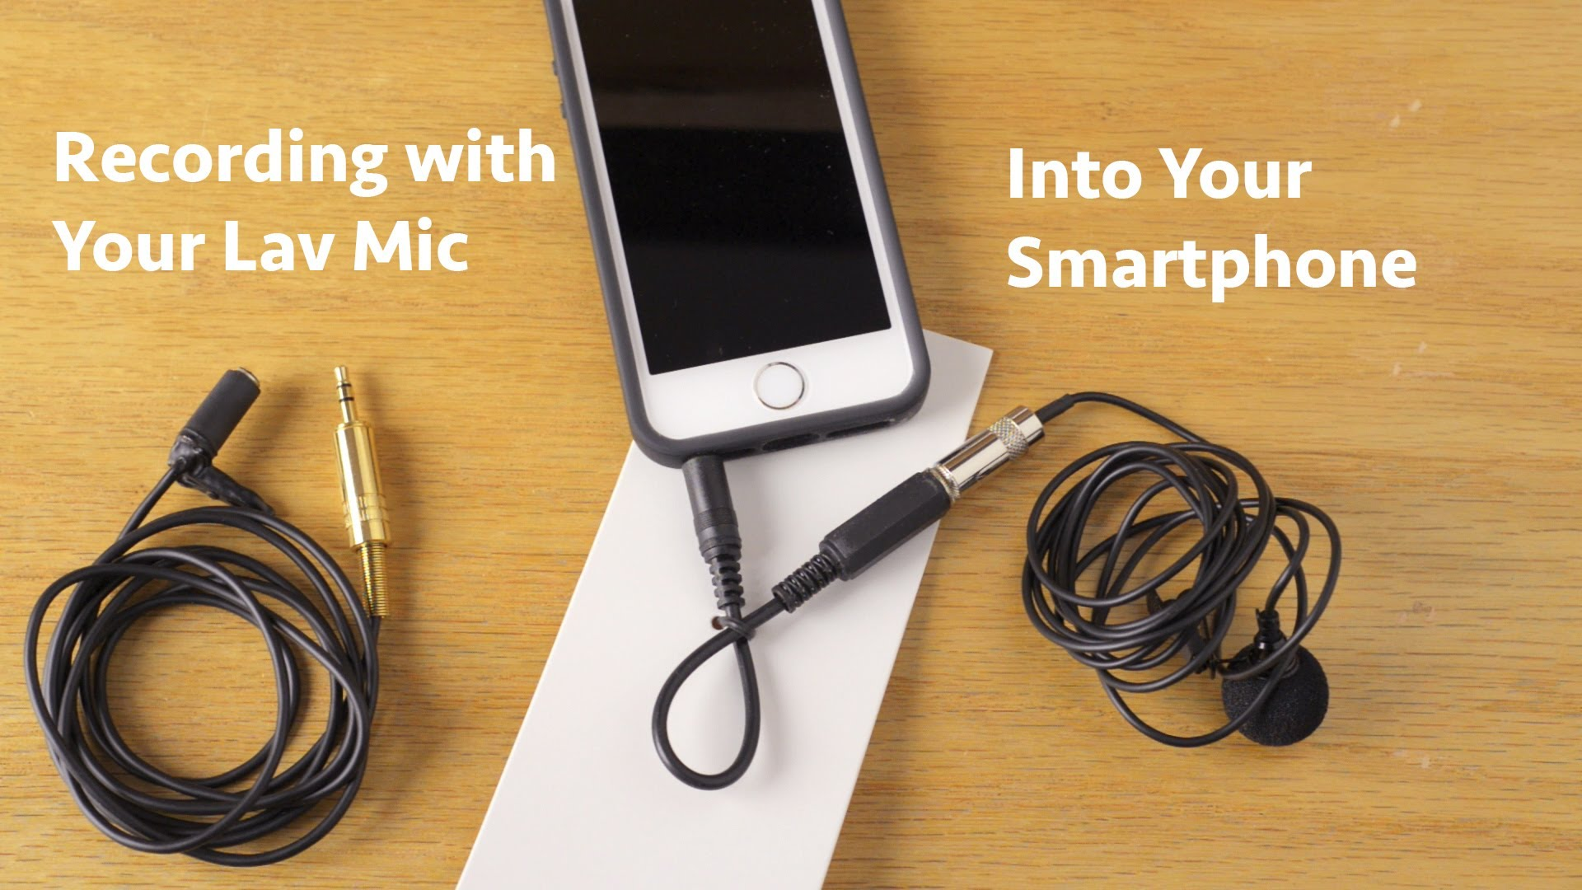

Slide 22
Equipment
Minimal Sound Requirements:
In Camera/phone
Sound Capture.

Slide 23
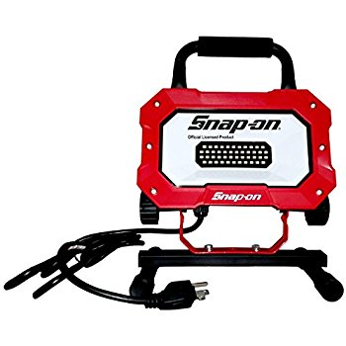
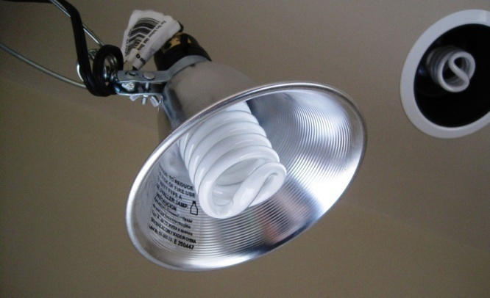
Equipment
Above Minimal Lighting Requirements:
Gels
3 Point Lighting Setup
3 cheap LED worklights from Home Depot
OR Powerful lights you have laying around

Slide 24
Equipment
Minimal Lighting Requirements:
Natural Light.

Slide 25
Equipment
Above Minimal Set Requirements:
A room with Art, A room Divider, A Blank Wall, etc.
A Chair?
A Table?
Any Props You Need
Any People You Need

Slide 26
Equipment
Minimal Set Requirements:
You in Any
Large Location.

Slide 27
Equipment & Location
Minimal Set Requirements:
You in Any
Large Location.

Slide 28
Equipment & Location
Absolute Minimal Needs:
A Digital Camera with Sound
Access to your Location or Set
Natural Light
That’s It!

Slide 29
Scheduling
In a Nutshell:
Tell people when to be where
Get everything set up beforehand
Direct everyone what to do
Execute the Shoot
Pack Up and Leave

Slide 30
Executing
Set
Lighting
Sound
Camera
Super Secret Tips and Tricks!

Slide 31
Executing Set
Set yourself as far as you can from your background, Unless your background is Awesome!!
It Doesn’t Matter what’s Out of Frame
Think Camera Perspective
Have something Visually Interesting in the shot
Background Movement, Art on walls, large open spaces

Slide 32
Executing Lighting
Standard 3 Point Lighting Works Wonders
Bounce, Hide, or Diffuse and Gel Every Light
Use what you have

Slide 33
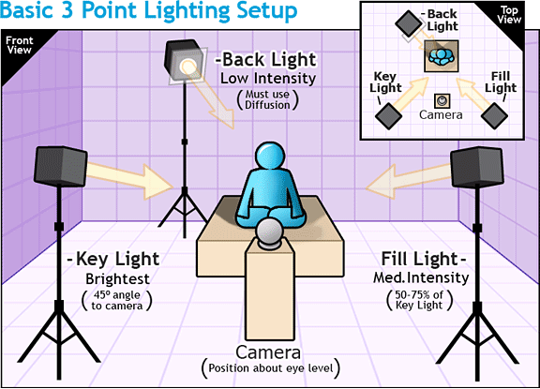

Slide 34

Gel, Diffuse, and Bounce Lighting

Slide 35
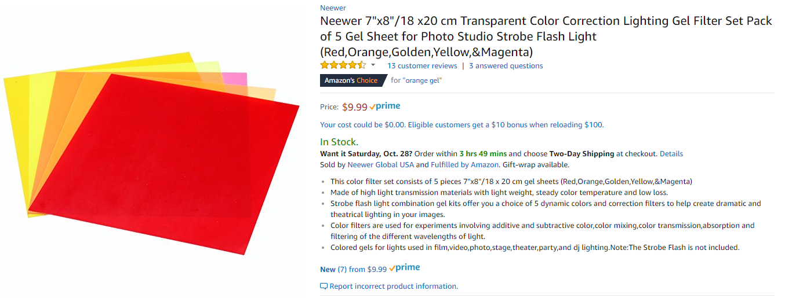
Gel, Diffuse, and Bounce Lighting

Slide 36
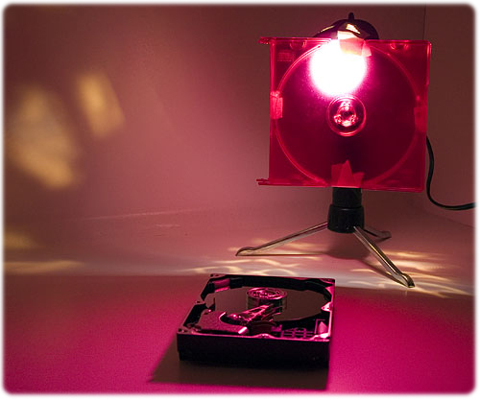
Gel, Diffuse, and Bounce Lighting

Slide 37
Gel, Diffuse, and Bounce Lighting

Slide 38
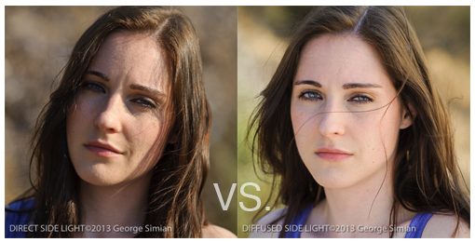
Gel, Diffuse, and Bounce Lighting

Slide 39
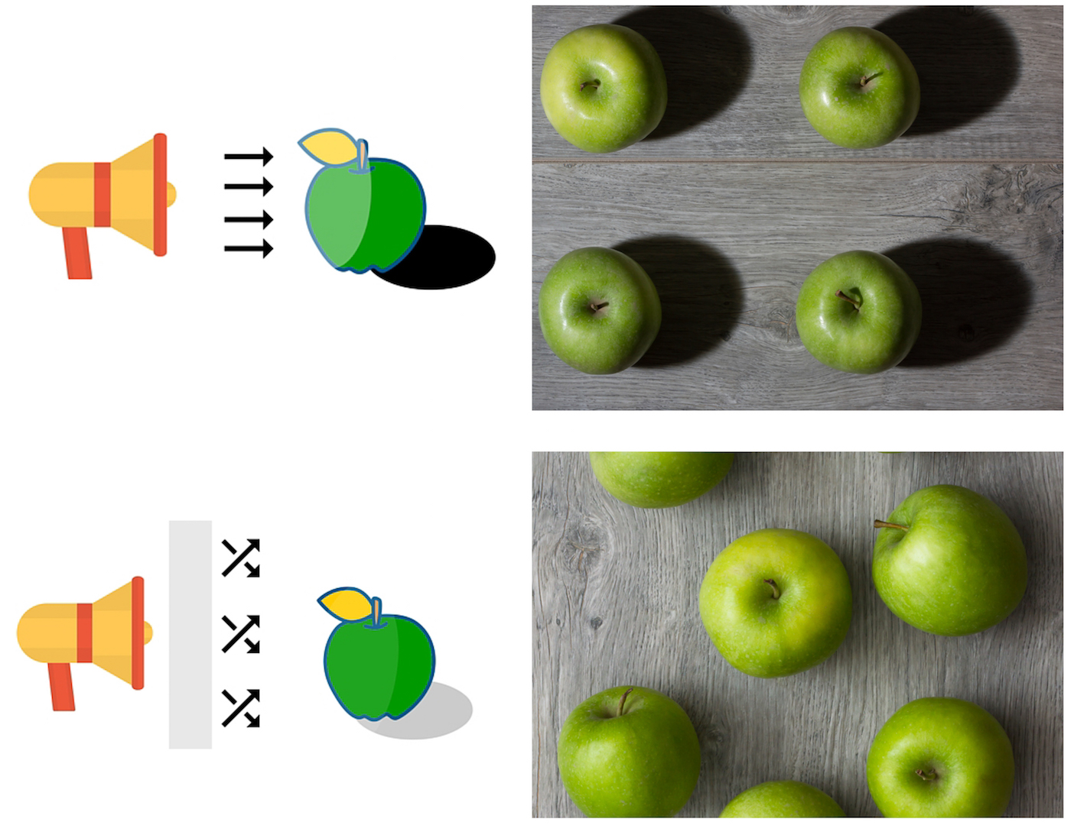
Gel, Diffuse, and Bounce Lighting

Slide 40
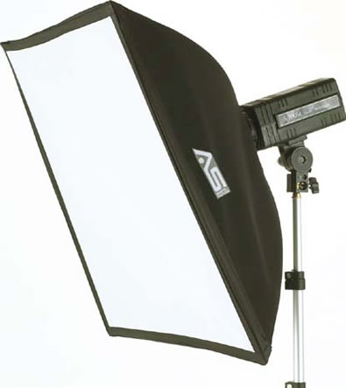
Gel, Diffuse, and Bounce Lighting

Slide 41
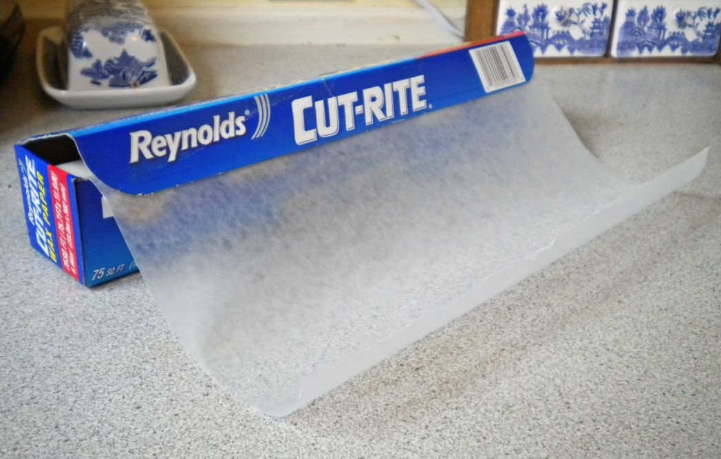
Gel, Diffuse, and Bounce Lighting

Slide 42
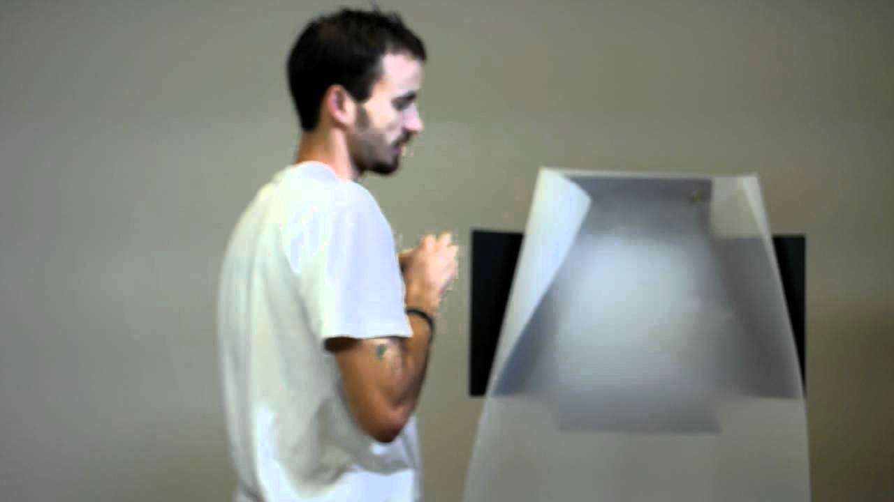
Gel, Diffuse, and Bounce Lighting

Slide 43
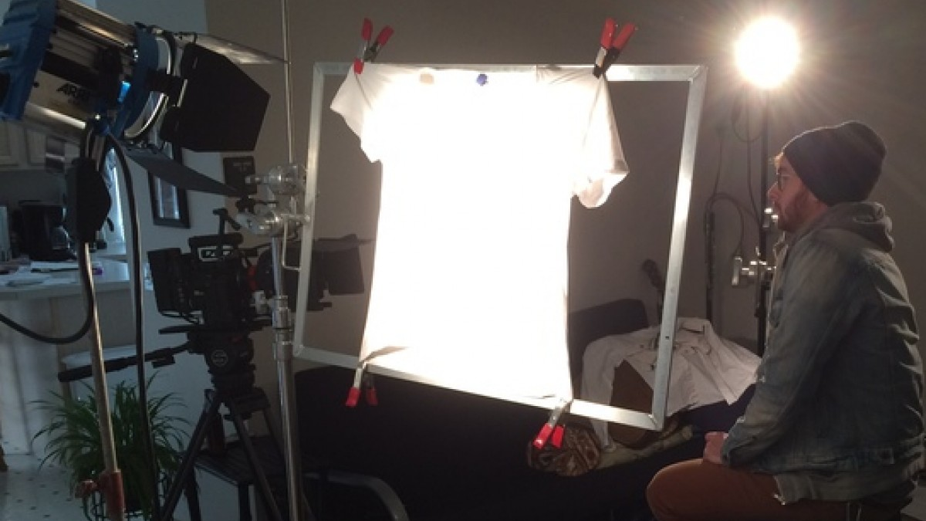
Gel, Diffuse, and Bounce Lighting

Slide 44
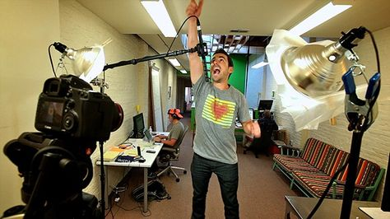
Gel, Diffuse, and Bounce Lighting

Slide 45
Gel, Diffuse, and Bounce Lighting

Slide 46
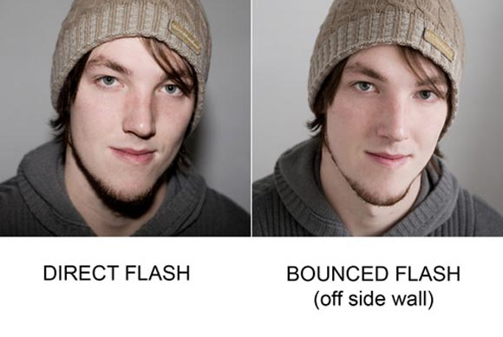
Gel, Diffuse, and Bounce Lighting

Slide 47
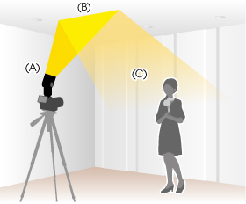
Gel, Diffuse, and Bounce Lighting

Slide 48
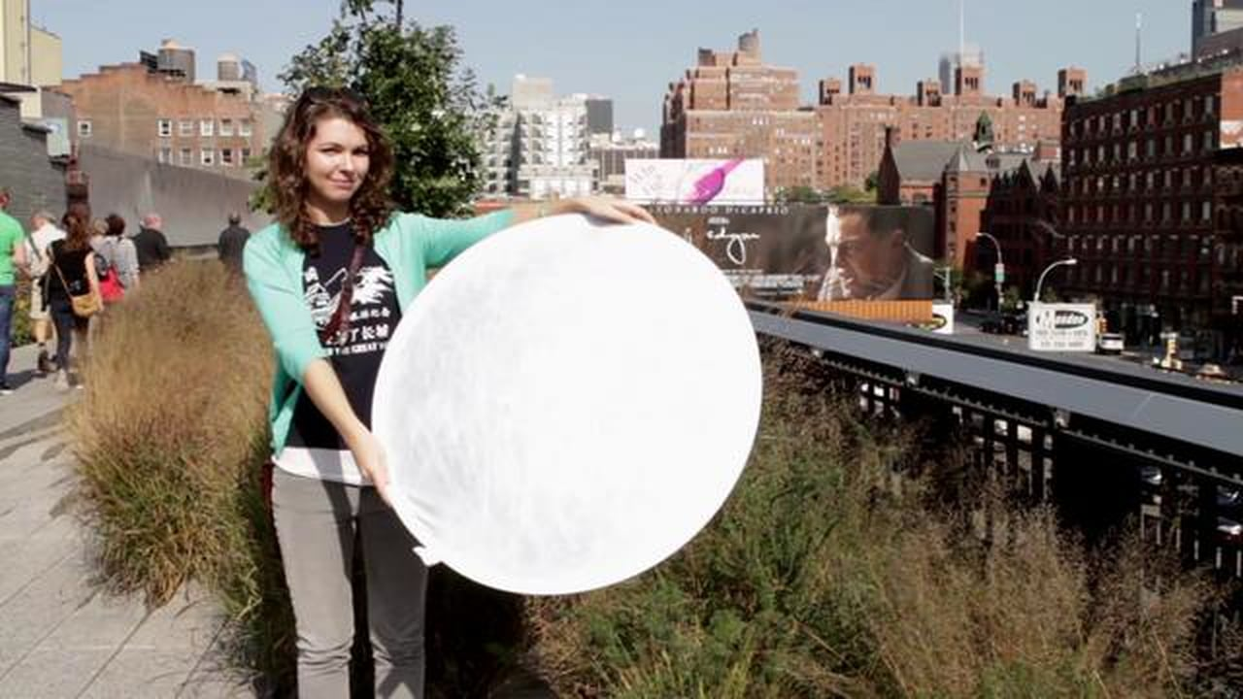
Gel, Diffuse, and Bounce Lighting

Slide 49

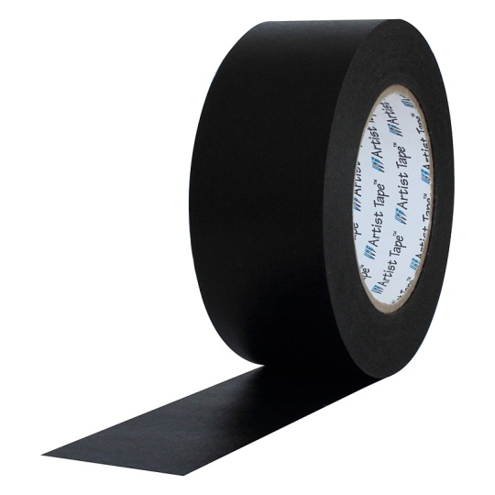
Gel, Diffuse, and Bounce Lighting

Slide 50
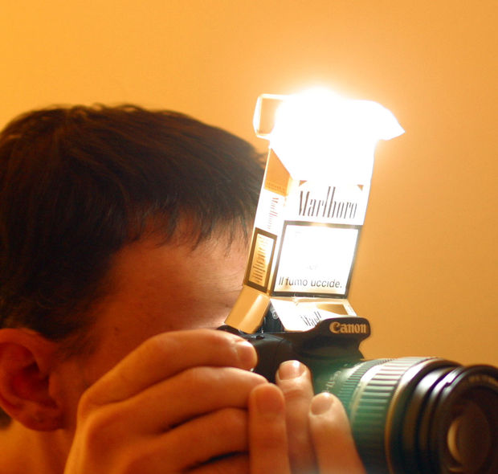
Gel, Diffuse, and Bounce Lighting

Slide 51
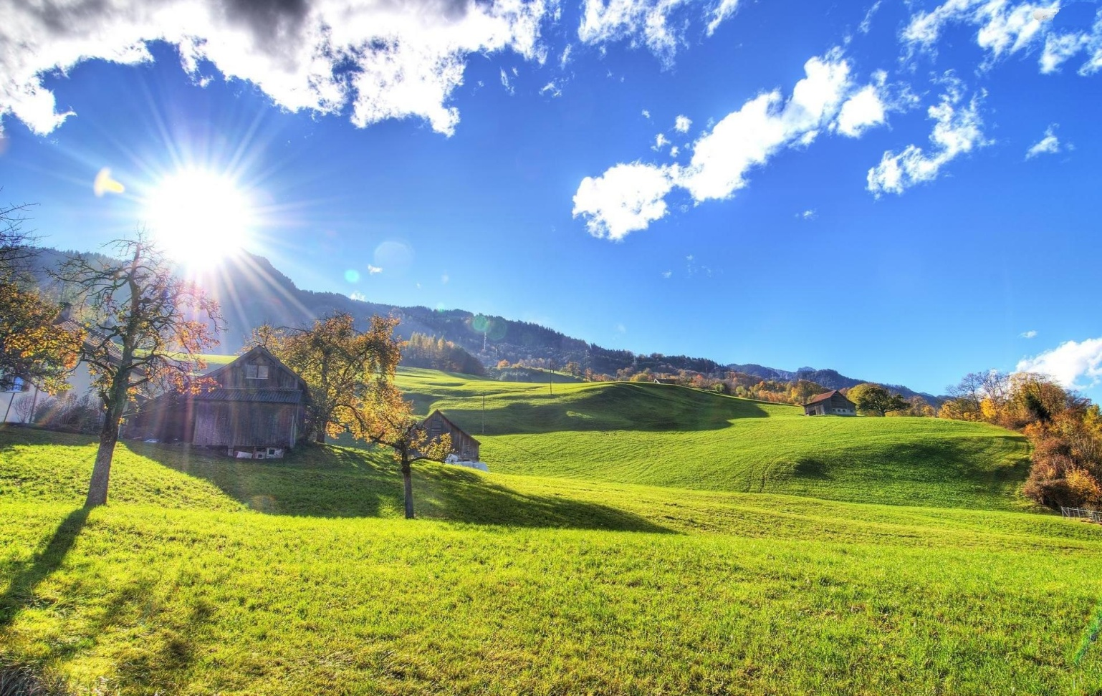

Use What You Have

Slide 52
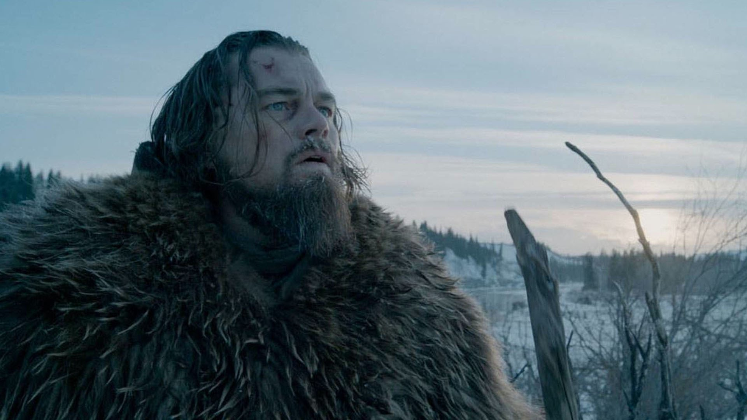
Use What You Have

Slide 53
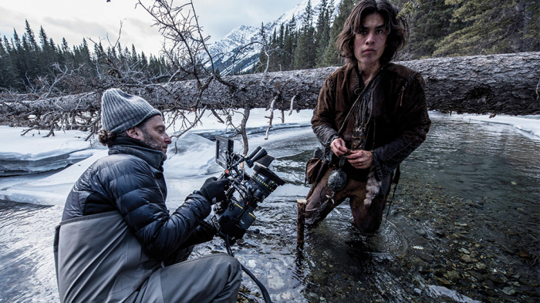
Use What You Have

Slide 54
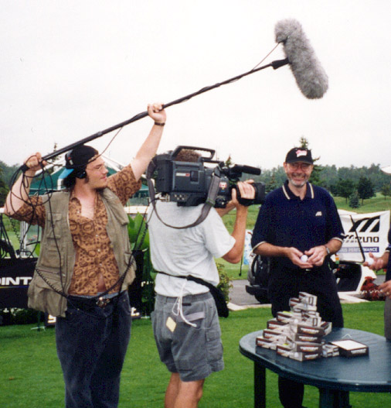
Executing Sound

Slide 55
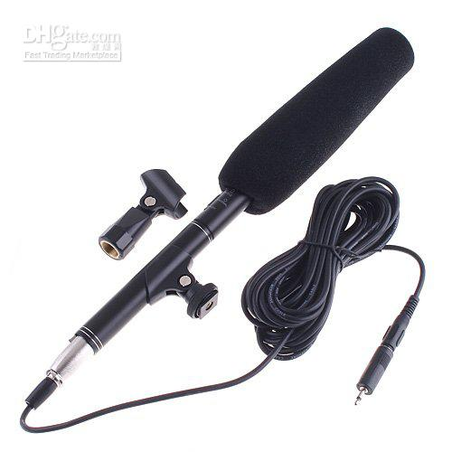

Executing Sound

Slide 56
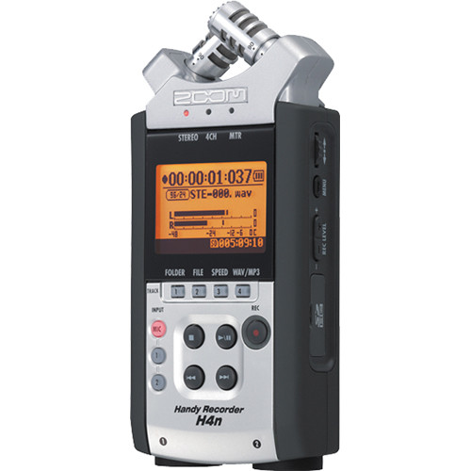
Executing Sound

Slide 57
Executing Sound
Basic Rules
Get your Mic as Close as Possible
You can hide your mic in the shot behind set
Make sure your recording levels Won’t Clip
Don’t Underestimate the Value of Good Sound!!

Slide 58
Executing Camera
Know your Camera, Learn your Camera, Love your Camera
Just having a good camera won’t give you good footage.
Follow the Rules, unless you know how to break them
Follow this order
Set, Frame, Light, Adjust Image, Test Sound, Record

Slide 59
Know your Camera

Slide 60
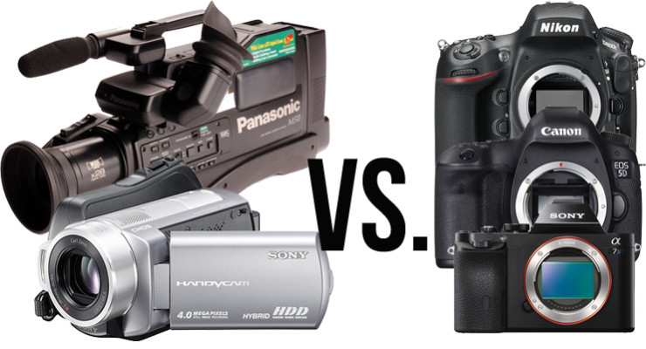
Know your Camera

Slide 61
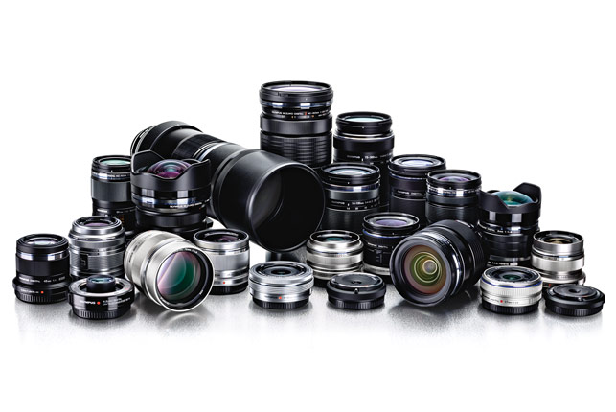

Slide 62
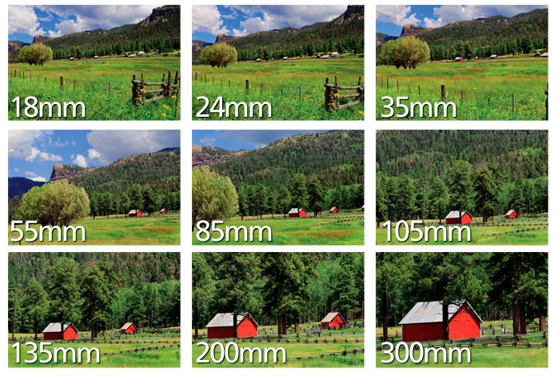

Slide 63
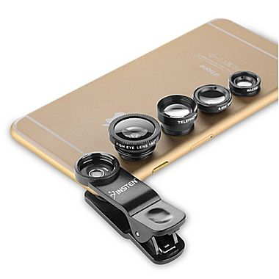

Slide 64
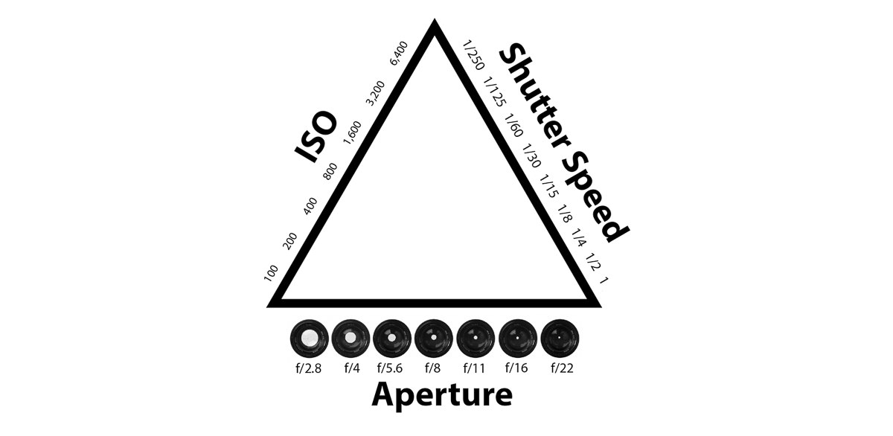
Exposure Triangle You’re playing with light, remember?

Slide 65
Exposure Triangle You’re playing with light, remember?
Amount of Noise
Crisp Vs Blurry Images
Depth of field

Slide 66
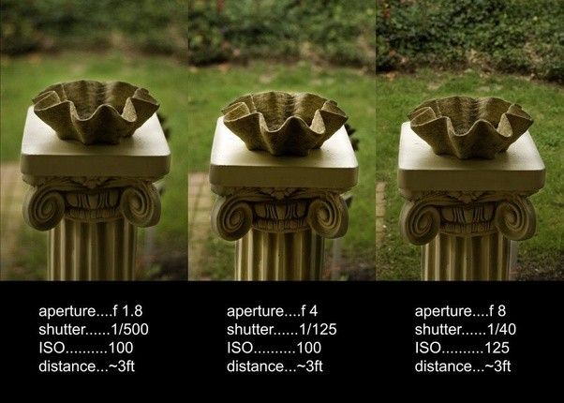
Exposure Triangle Aperture + Depth of Field

Slide 67
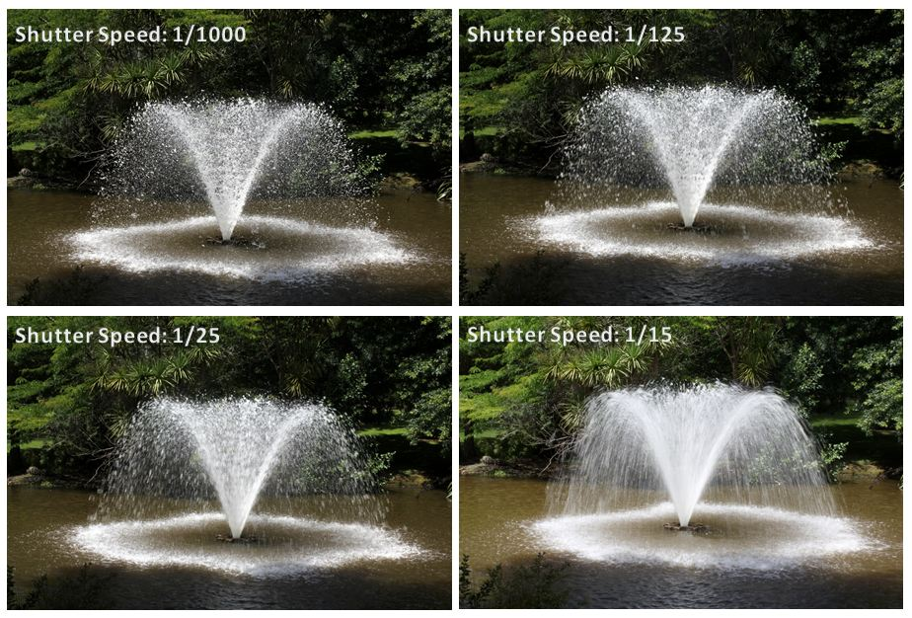
Exposure Triangle Shutter Speed + Crisp vs Blurry

Slide 68
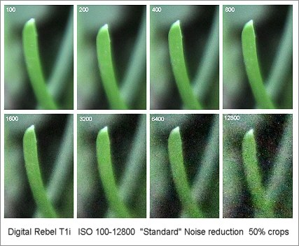
Exposure Triangle ISO + Noise

Slide 69
Camera Rules (break at your own risk)
NEVER 30fps! Either 24fps or 60fps
Shutter Speed = At least 2x your FPS (24fps = at least 1/50th)
The Higher you FPS, The more Actual Light you NEED
Adjust setting in this order: Aperture, Shutter, ISO
When using High ISO, Shoot something Colorful and Bright.
When you can’t fix something in-camera, Change your set, lighting, or framing.
Don’t Fix It In Post! Post is where projects go to die!

Slide 70
Camera and Filming Tips
Plan your project Fully before you buy Anything!
You can rent expensive equipment with 2 day shipping!!
Shoot in a higher resolution than you plan to publish in.
Sound Tip: Small rooms are better, but corners echo the most.
Use Autofocus to pull focus, Then switch it to Manual.
Friends and favors for filming are fantastic!
Cut Corners when appropriate.

Slide 71
Executing Post Production
Don’t Edit if you Don’t Need To!
Editing is a Full Class in itself
Premiere Pro or iMovie?
Take the time to learn the skills, or Hire someone to do it right!

Slide 72
Executing Production and Distribution
DVD or Digital Download
Back of Room Sales and Beyond!!
Free DVD Image Creator (like iSkysoft DVD Creator)
Some customizability, easy usability, and it’s Free!!
Or… Hire it out?

Slide 73
How does DVD Production break down?
4.7 GB – 120 minutes – 6 color label = 100-499 @ $.50 ea ($50-$250)
Cases – about $20-$25/100
Inserts and cover art – Color Printing and Cutting – $.30-$1/DVD
Total DVD Production on the Cheapest end – About $2-$4/DVD
$200-$400 buy-in cost with 10-20x or more markup potential
Cheaper option – About $120 minimum for 100 Self-Burn DVD’s

Slide 74
How does DVD Production break down?
4.7 GB – 120 minutes – 6 color label = 100-499 @ $.50 ea ($50-$250)
Cases – about $20-$25/100
Inserts and cover art – Color Printing and Cutting – $.30-$1/DVD
Total DVD Production on the Cheapest end – About $2-$4/DVD
$200-$400 buy-in cost with 10-20x or more markup potential
Cheaper option – About $120 minimum for 100 Self-Burn DVD’s
CHEAPEST OPTION – Amazon S3 (Simple Storage Services)
About $.12 per month to store and about $.18 each time you serve a 1.5GB Video + Print distribution with a download code

Slide 75
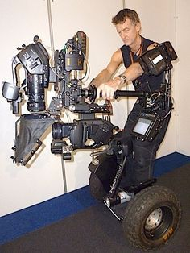

Slide 76
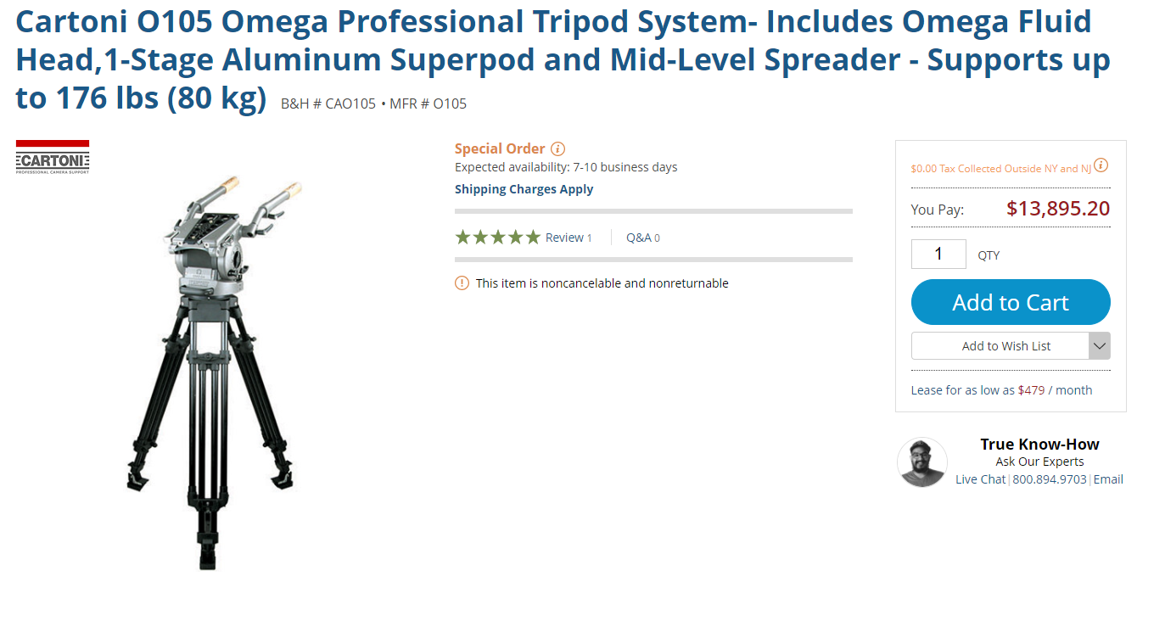

Slide 77
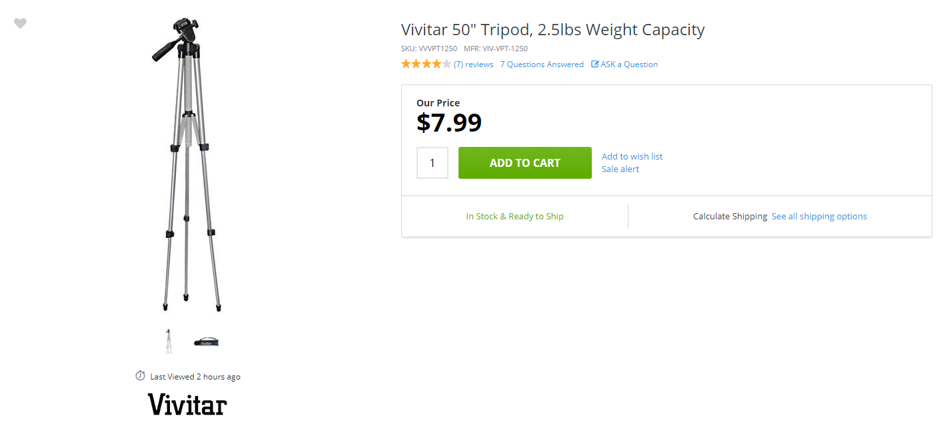

Slide 78


Slide 79


Slide 80


Slide 81


Slide 82
Resources
Youtube.com/FilmRiot
Rent Camera Equipment - BorrowLenses.com
DVD Printing - BlankMediaPrinting.com
Me, Nick Fedoroff – Facebook - SBBP

Slide 84


