Slide 1


MEET

Slide 2
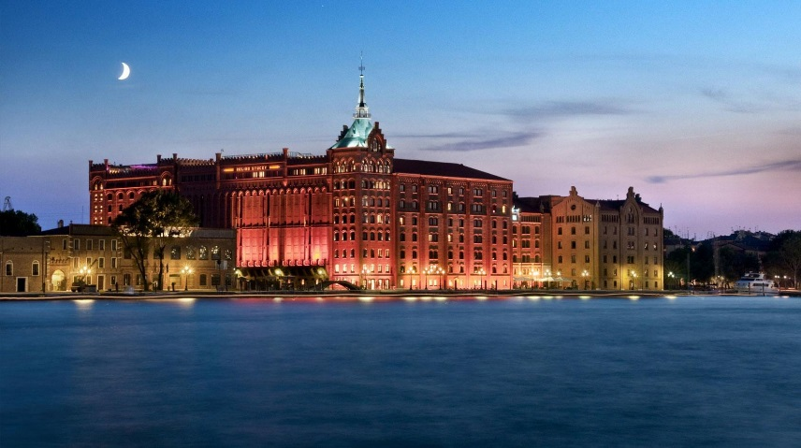
Hundred Percent Club – 2016 Europe
Mid May, 2016 ■ Venice, Italy

Slide 3

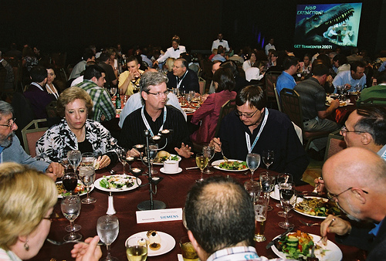
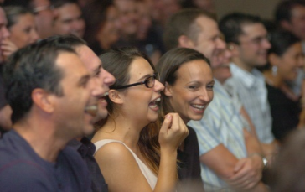
After Reviewing Details With Mark Felix
Three waves of top-producing 100%’ers
Approximately 565 per wave
Morning performance that is fun / visual / engaging
A Perfectly Fine Audience
IBM 100% Club Audience

Slide 4
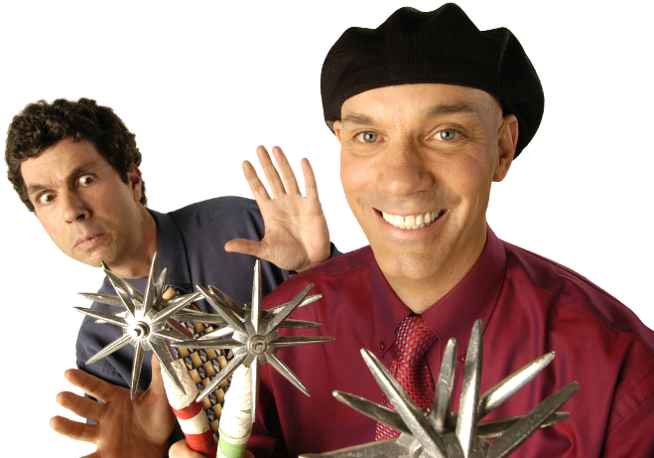
What’s a Raspyni – And Why Should IBM Care?
Over 200 National TV shows
2,000 Corporate Events
4-time World Juggling Champs
Your event is all that matters
Expand camaraderie among your guests
Customize using your products and messages
Bring humor, motivation, and focus

Slide 5
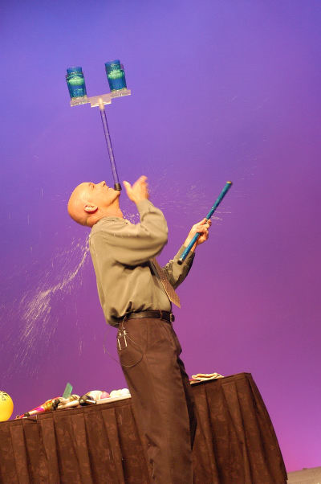
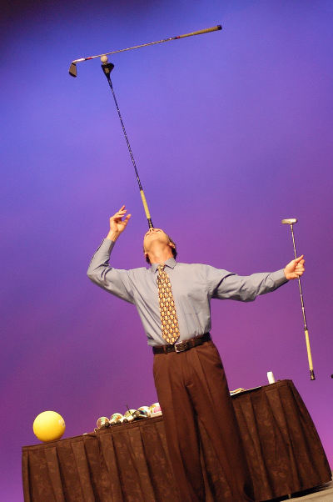
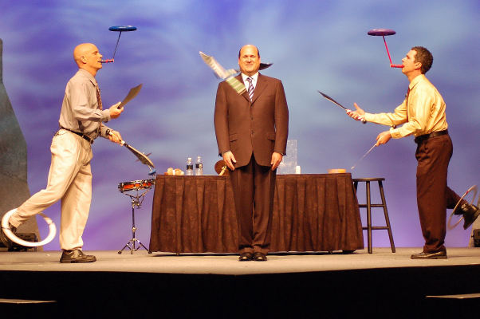
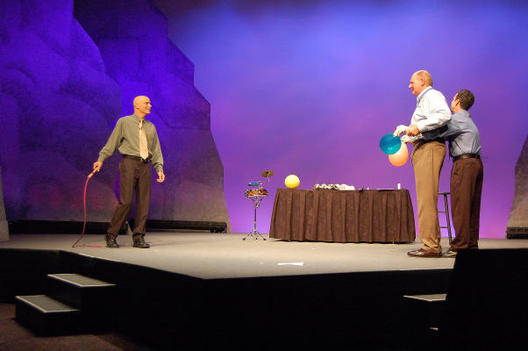
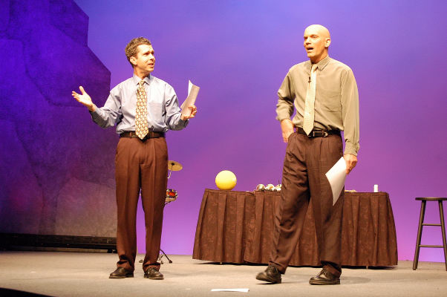
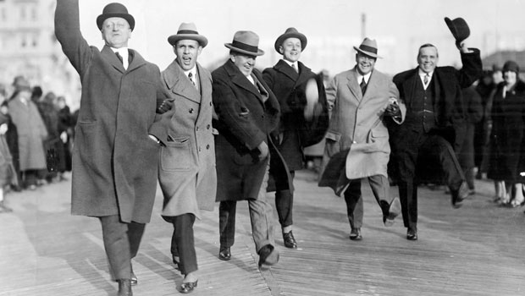
What Will They See?

Slide 6

What Will They Feel?
Benefits of Laughing
Antidote to Stress, Pain, and Conflict
Connected to the Group
Relaxed and at Ease
From the Message
IBM is Creative
IMB is Progressive
IBM Celebrates Success
They’ll Continue to Count On All This and More

Slide 7
Resources That Show We’re Worthy of IBM’s One Hundred Percent Club
6 -Time Presenters at TED Conference
Over 2,000 Corporate Shows since 1986
Guinness World Record Holders
Link to a One Hour Performance – Really!
Link to Letter About Customization Skills
Work one-on-one with you

Slide 8
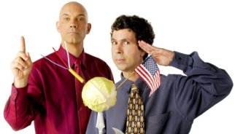
Hundred Percent Club – 2016 Europe
Mid May, 2016 – Venice, Italy

