Slide 1


MEET

Slide 2
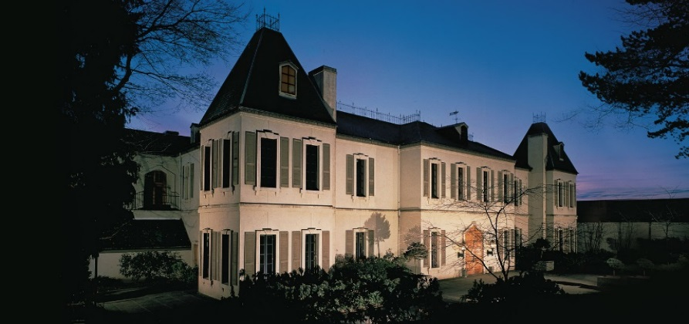
30th Anniversary Celebration
May 12, 2016 ■ Woodinville, WA

Slide 3
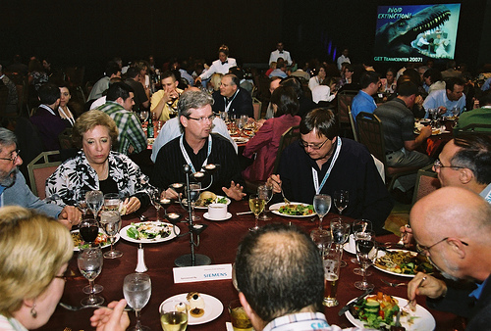
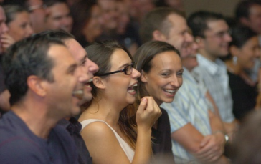
After Reviewing Details With Asako
3 hour event for employees, spouses, and other VIPs
Approximately 150 guests
30 minutes - motivational, entertaining, and visual!
A Perfectly Fine Audience
Micro Encoder Audience

Slide 4
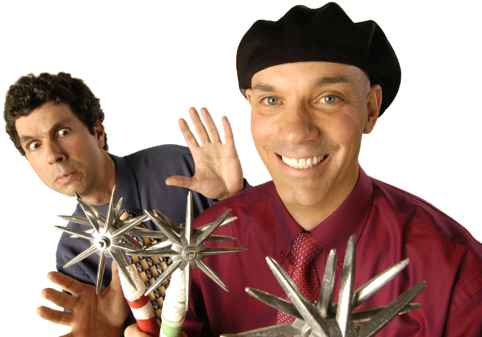
What’s a Raspyni – And Why Should Micro Encoder Care?
Over 200 National TV shows
2,000 Corporate Events
4-time World Juggling Champs
Your event is all that matters
Expand camaraderie among your guests
Customize using your products and messages
Bring humor, motivation, and focus

Slide 5
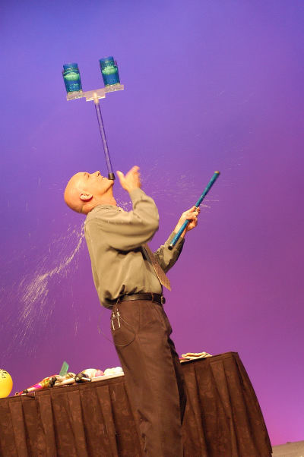
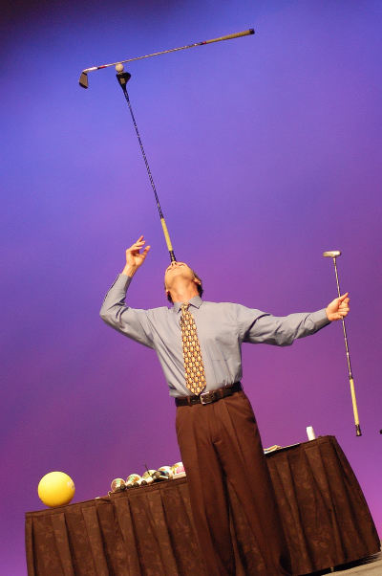
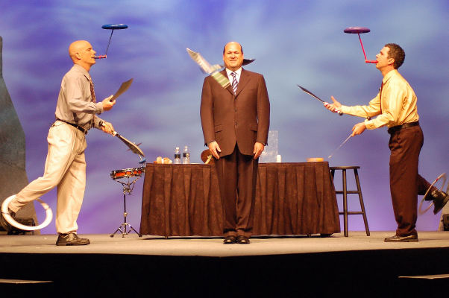
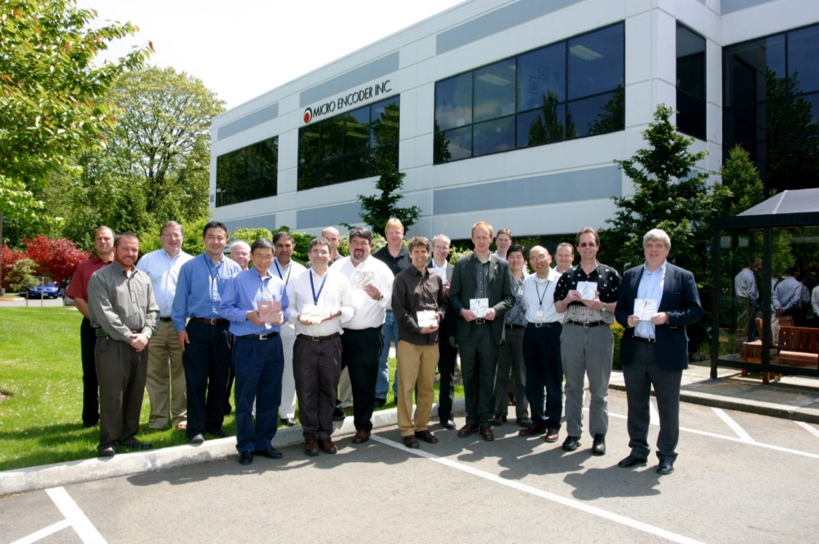
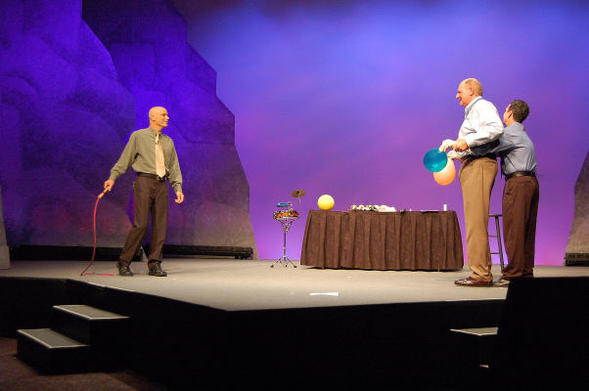
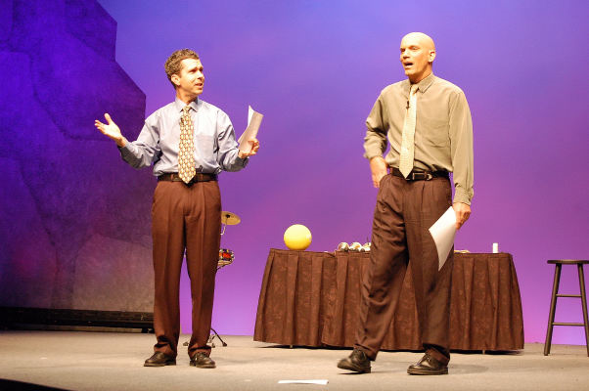
What Will They See?

Slide 6
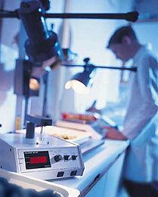
What Will They Feel?
Benefits of Laughing
Antidote to Stress, Pain, and Conflict
Connected to the Group
Relaxed and at Ease
From the Message
Micro Encoder is Creative
Progressive
Celebrates Success
They’ll Continue to Count On All This and More

Slide 7
Resources That Show We’re Worthy of Micro Encoder’s 30 Anniversary
6 -Time Presenters at TED Conference
Over 2,000 Corporate Shows since 1986
Guinness World Record Holders
Link to a One Hour Performance – Really!
Link to Letter About Customization Skills
Work one-on-one with you

Slide 8
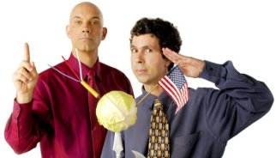
30th Anniversary Celebration
May 12, 2016 – Woodinville, WA

